Slide 1

Mitron Bank
Created by – Arjun Naik
AtliQ Data Services

Slide 2
Introduction
Mitron Bank a 40 years old legacy financial institution, Providing services and leveraging agile frameworks thus helping Values grow Safely and foster a consumer-first mindset.​
Problem Statement
wanting to introduce a new line of credit cards, aiming to broaden its product offerings and reach in the financial market.
AtliQ Data Services

Slide 3
Agenda
1
2
3
4
5
Introducing New Credit-Cards
Broaden Product Offerings
Reach in Financial Market
Understanding Customers Demographics
Trends Analysis

Slide 4
Task
Demographic classification
Average income utilisation
Spending Insights
Key Customer Segments
Credit Card Feature Recommendations

Slide 5
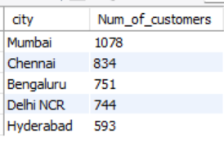
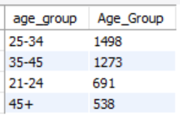

Demographic classification:
#1 Classification the customers based on available demography
Most Number of customers
City wise -- Mumbai (1078)
Gender – Male (2597) 64.93 % of total
Age Group – 25-34 (1498)

Slide 6
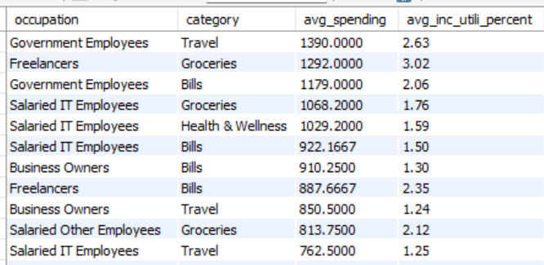
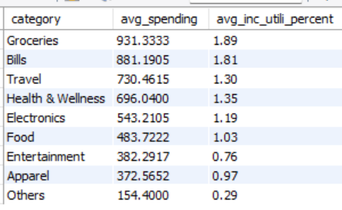
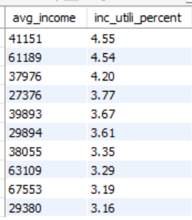
Average income utilisation
#2 Average income utilisation % of customers
Most Income Utilization
Category- Groceries (931) i.e 1.89%of total.
Occupation – Government -Travel (1390) i.e 2.63% of total.

Slide 7
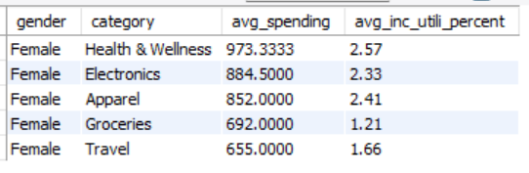
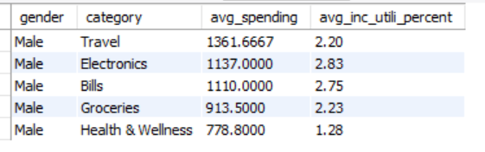
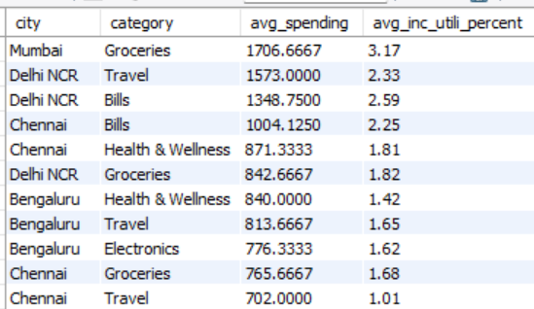
Spending Insights:
#3 Where do people spend money the most?
Spending Insights (Credit Card Users)
Gender + category Male – Groceries (~1080)
Female – Health & Wellness (~1043)
City + Category
Mumbai – Groceries ( ~1706)

Slide 8
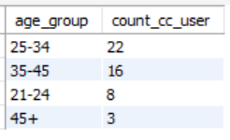
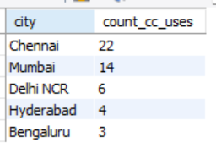
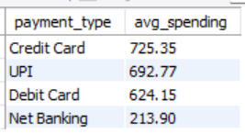
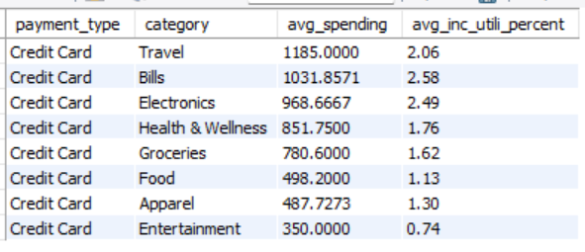
Key Customer Segments
#4 identify and profile key customer segments
Customer Segments Analysis
Average Spending – credit card (725)
Most cc usage city – Chennai
Top 3 categories with Highest Spending
Travel (1185)
Bills (1031)
Electronics (968)
Age Group – 25-34 (22)

Slide 9
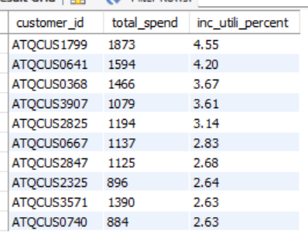
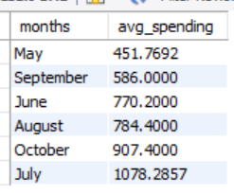
Top-10 Highest Spending Customers Of Credit-Card
Top-10 Lowest performing Months

Slide 10





+ Feature Recommendations
Broadening Customer Segment in Females which is 30% than Males.
Increasing Customers in the Least credit card usage cities (Delhi, Hyderabad, Bengaluru).
Advancing perks in categorise(Food, Groceries, Entertainment).
Exploring Student Credit-Cards for Increasing 21-24 Age Group / customers.
Extra Perks For the Most Spending Customers

Slide 11
How we get there​
Partnering with online Food Delivery apps as well as Premium Restaurants to offer your Services.
Sponsoring online multimedia apps and Streaming Platforms For Your Service Options.
​
Implementing ways to counter Sales Drop in 2nd Quarter .
Marketing and Advertisements in Low User Cities.
Cultivate one-to-one customer service with
Instant Solutions.
Assuring Extra Perks for most spending / using Services for Customers

Slide 12
Thank you
-Arjun Naik
AtliQ Data Services
arjunnaik8860@gmail.com

